Slide 1
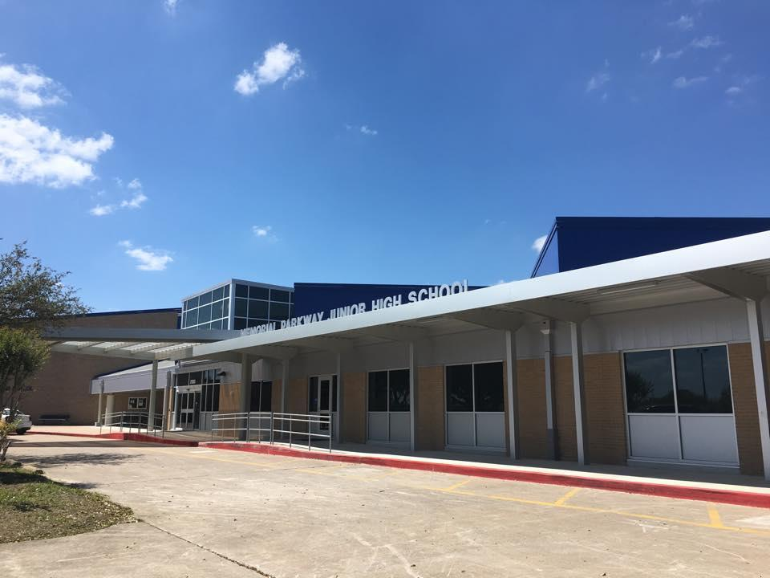
MPJH Course Selection
Incoming 7th grade
EAGLES ARE:
Trustworthy Accepting Leading Optimistic Noble Scholarly

Slide 2
MPJH Counselors
2024-25
Mrs. Garcia
Counselor
6th
Mrs. Tompkins
Counselor
7th
Mrs. Hardy
8th

Slide 3
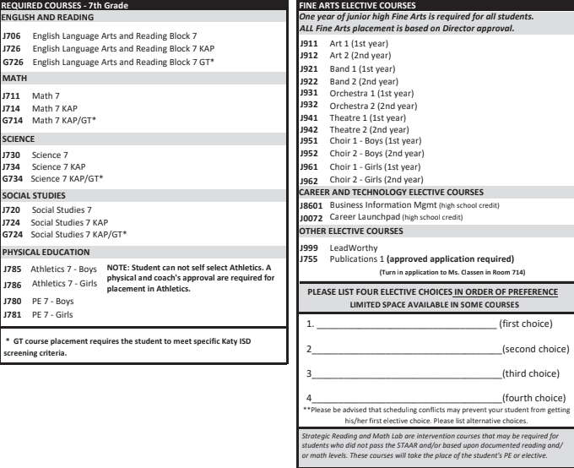
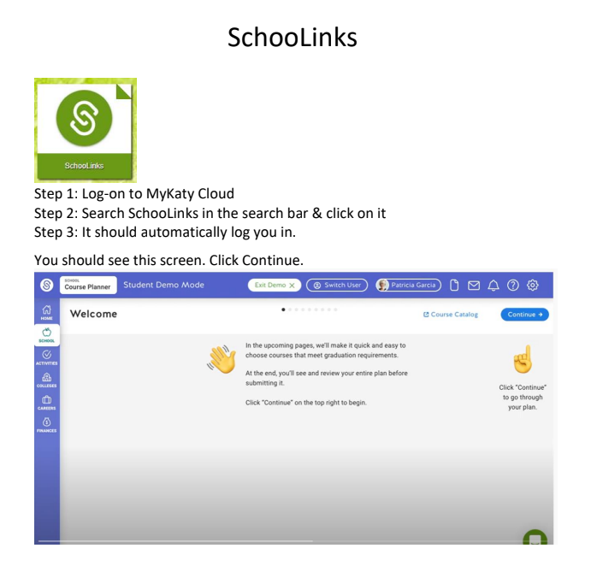
Course Selection Materials
Click Link and Watch SchooLink Video
SchooLink Directions Video.mp4
New this year!
You will enter course in SchooLink this year.
*Available on Counselors MPJH Website, Science & ELAR Canvas Page

Slide 4
Three Class Formats
Academic – For everyone, on grade level, more time to review concepts, more tutoring provided, prepares students for college as well as other post secondary education
KAP (Katy Advanced Program - formerly called Pre-AP)– More challenging, fast paced, requires independent learning, prepares students for AP classes in high school *Recommend current average of B or higher in specific subject grade
GT – Must be currently screened and identified
Students who enroll in KAP, KAP/GT, and AP/GT English Courses in grades 6-12 are expected to complete a summer reading assignment.

Slide 5
Academic Math vs. KAP Math
7th grade academic math: Students will continue with current on level curriculum for the year.
7th grade KAP math: Students will complete remainder of 7th & 8th grade math. with successful completion of 7th grade KAP math student will be eligible to take High school Algebra in the 8th grade.
7th grade KAP math students will take the 8th STAAR
Current high achieving students (95 average or higher) in 6th grade KAP math can take a Credit By Exam for 8th math this summer. Students who pass the 8th grade math CBE will be eligible to take Algebra in the 7th grade.

Slide 6
Academic vs KAP English & Reading
KAP/AP courses are designed to challenge motivated students and prepare them for success in college level coursework in high school and beyond. These advanced or above grade-level courses move at a faster pace, are more academically challenging and require more independent learning than academic courses.
Students who enroll in KAP, KAP/GT, and AP/GT English Courses in grades 6-12 are expected to complete a summer reading assignment.
All students in junior high school ELA have the same curriculum.

Slide 7
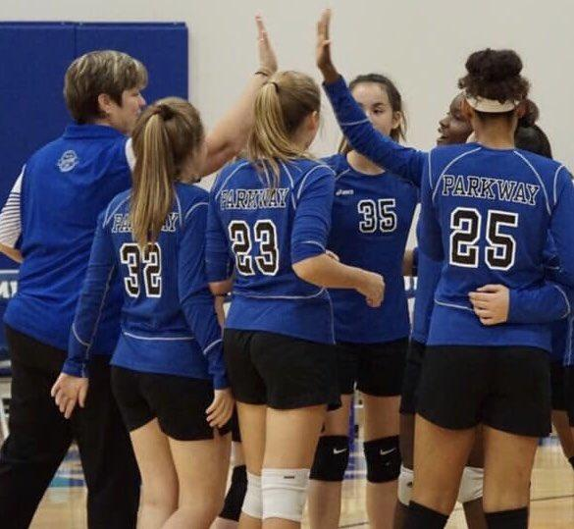
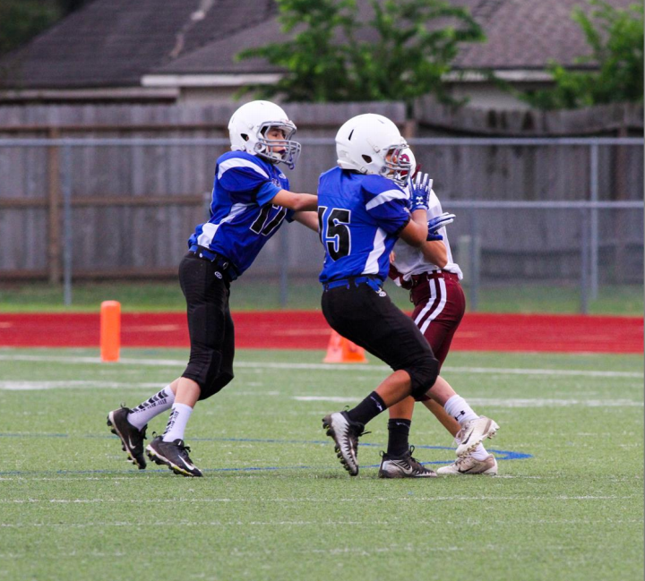
PE vs. Athletics
Based on Tryouts during the 6th grade school year.
Coaches determine placement into athletics
Must have Physical on file dated after May 1, 2024 & Rankone online forms completed.
Athletic period sports:
Football,
Volleyball,
Basketball,
After school sports not placed in the athletic period:
Soccer
Track
Tennis

Slide 8
Strategic Reading and Math Lab
Students in the 6th grade who are unsuccessful on the 1st administration of STAAR in Math and/or Reading this Spring may be placed in a Math Lab or Reading Improvement class, but all will have the state required 30 hours of Accelerated Instruction. These classes may replace an elective and/or PE in 6th grade.
Small class sizes 15:1 ratio to provide support in Math or Reading

Slide 9
Electives All Junior High Students Must Take a Fine Arts
Band * Orchestra * (Band /Orchestra directors will contact you before school is out about an instrument selection) Choir * Theatre Art
Leadworthy
Business Information Management
Career LaunchPad
*Supply Fees required

Slide 10
Electives
Career Investigation: The goal of this course is to create a foundation for success in high school, future studies, and careers in areas of Science, Technology, Engineering, and Mathematics; Business and Industry; Public Service; Arts and Humanities; and Multidisciplinary Studies. The students research labor market information, learn job-seeking skills, and create documents required for employment.
LeadWorthy: This course helps students develop leadership and personal and business skills as they learn to be responsible members of their community.
Publications: Students apply writing skills to the publication of the school yearbook.
HIGH SCHOOL CREDIT:
Career Launchpad - The goal of this project-based course is to give students an opportunity to become familiar with the different CTE programs offered by Katy ISD during high school. It will be a rotation of the programs to help students have a better understanding of what each course had to offer, so they are able to make informed decisions during their high school course selection/planning process.
Business Information Management- Students learn computer skill essentials for college and work readiness using the industry standard Microsoft Office Suite. Students produce a variety of Word documents create Excel spreadsheets and charts, develop and maintain Access databases, and design professional PowerPoint presentations. Outlook is introduced as a necessary skill in college and work. There are two programs of study in this cluster (Accounting & Financial services and Business Management)
Publication Application Deadline is Friday, February 8th.
Application are in the Cafeteria.

Slide 11
Dropping A High School Credit Class
Katy ISD Policy for Dropping High School Credit Courses
End of 1st Six Weeks: Any student with a failing grade will automatically be removed from the HS credit class & the grade WILL NOT be recorded on the HS transcript/GPA.
The ONLY time a student can request to exit a HS credit course is during the 1st six weeks!
End of the 2nd Six Weeks: Any student with a failing grade will automatically be removed from the HS credit class & the grade WILL NOT be recorded on the HS transcript/GPA.
This is the last time an automatic drop will occur until the end of the 1st semester.
3rd Six Weeks: Any student that is failing during this time will remain in the class until the end of the semester. The teacher will work with the student to bring their grade up.
End of 1st Semester: Any student that ends the 1st semester with a failing grade will be removed from the class. The grade WILL BE recorded on the HS transcript/GPA.
NO drops will occur any time during the 2nd semester!

Slide 12
Dropping A High School Credit Class
If a student tries to drop a high school credit class after progress report of the 1st six weeks because he/she is failing, the student will lose eligibility for UIL purposes.
Parents must sign the form for students to remain in a high school credit class if he/she is failing after the 2nd six weeks. By signing the form, parents agree that the school is recommending that they switch electives (to avoid hurting high school GPA). The student will remain in the class for the rest of the semester and the grade will be recorded on the student's transcript.

Slide 13
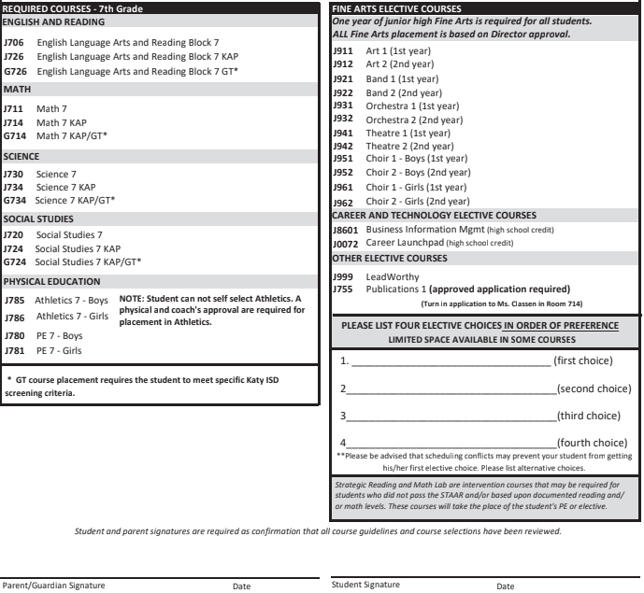
Completing Course Selection Sheet
Legal first and last name
Level of core classes (Aca., KAP, GT) (Reading and English blocked)
LIST 4 ELECTIVES COURSE CHOICES BELOW IN ORDER OF PREFERENCE
Parent & student signature needed
Parent & student must also read and sign the back of the course selection sheet if selecting any KAP classes.
Return course selection worksheet to your ELAR Teacher by February 8th.
ENTER COURSES IN SCHOOLINKS!!!
J962 Choir
J0072 Career Launchpad
J912 Art 2
J999 LeadWorthy
Evan Brown 2/4/2024
Eva Brown 2/4/2024

Slide 14
After today...
Turn in Course Selection Worksheet to your RLA Teacher by Feb 8th.
One-on-One with Counselor will be February 12th - 20th in all RLA classes.
Course Verification Letters will be in SchooLinks and all corrections will be submitted through comments in SchooLinks
THIS IS NOT A SCHEDULE!!!
Follow instructions for how to make changes on the course verification sheet.
Course Selection Timeline: Will be on the Counselors’ Page online, Science, & RLA Canvas pages.
All links are listed on timeline.

Slide 15
Common Questions
What if my future math class is not listed?
What if I am being screened for GT?
What if I have a P.E. Waiver?
What if I change my mind on a class?
Can I pick specific teachers?

Slide 16
Academic vs. Pre AP Science
PreAP & PreAP/GT courses provide for the development of skills and concepts necessary for success in Advanced Placement courses in high school
All students in middle school science have the same curriculum.
Tests: PreAP/ GT students have a writing portion (Open Ended Response-OER) in addition to the multiple choice portion of the test.
Menus: PreAP/GT students will have “menus” in which they will have approximately one week to complete a product of their choice. Menu requirements will be discussed at the beginning of each unit.
Extension labs and activities will be planned throughout the year.

Slide 17
Academic vs. PreAP Social Studies
All classes cover the same state standards, but Pre-AP classes are differentiated in the following ways:
Rigor of tests: Higher level test questions, require students to apply knowledge at a greater depth.
Projects: Differentiated Requirements
Writing assignments - Inquiry Questions
Activities that prepare Pre-AP students for AP courses in High School

